Slide 1
Passerelles numériques
A Gateway for Life
03-Get started with Java Programming

Slide 2
Outline
Datatypes
Operators
Control Statement
Loop

Slide 3
Datatype
Primitive data type
Reference data type

Slide 4
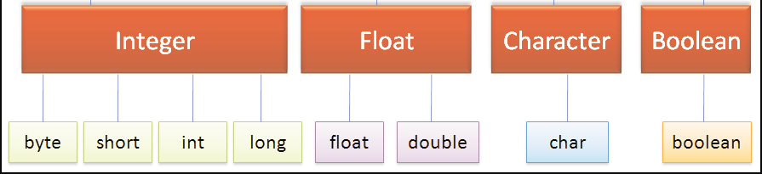
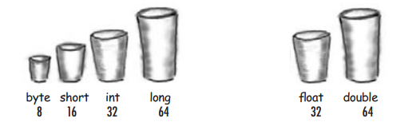
Primitive data type
Notes:
int and double are the most often data type used

Slide 5
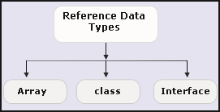
Reference data type
Notes:
These types will be studied in the next chapter

Slide 6
String
Java's String is designed to be in between a primitive and a class
Ex:
String welcome = "Welcome WEP2019"; //String literal
String hello = new String("Hello WEP2019"); //String object
Notes:
Primitives are stored in the call stack, which require less storage spaces and are cheaper to manipulate. On the other hand, objects are stored in the program heap, which require complex memory management and more storage spaces.

Slide 7
Example
// declaring character
char character = 'G';
// declaring boolean
boolean isOpen = false;
// Integer data type is generally used for numeric values
int iNumber=89;
// use byte and short if memory is a constraint
byte byteNumber = 4;
short shortNumber = 56;
// by default fraction value is double in java
double data = 4.355453532;
// for float use 'f' as suffix
float fData = 4.733f;
Notes:
-char storing a character value. can’t assign more than a character. if we assign integer value it will convert into character based on asci code
-byte/short is similar to int, different in the term of memory storing space
-double: decimal number, this data type is generally the default choice
-float: to save memory

Slide 8
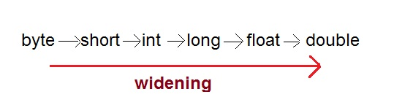
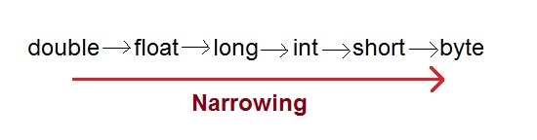
Type Casting
Implicit
int number = 300;
double dNumber = number; //implicit casting or automatic casting
Explicit
int iNumber = 20;
byte bNumber = (byte) iNumber; //explicit casting

Slide 9
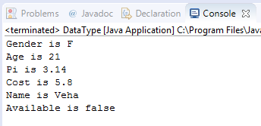
Activity#1
Create variables as following and display their values on console
gender = F
age = 21
pi = 3.14f
cost = 5.8
name = “Veha”
isAvailable = false
10mn
Notes:
char gender = 'F';
int age = 21;
float pi = 3.14f;
double cost = 5.8;
String name = "Veha";
boolean isAvailable = false;
System.out.println("Gender is "+gender);
System.out.println("Age is "+age);
System.out.println("Pi is "+pi);
System.out.println("Cost is "+cost);
System.out.println("Name is "+name);
System.out.println("Available is "+isAvailable);

Slide 10
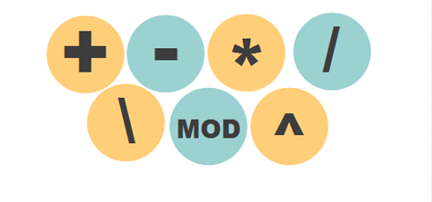
Operator

Slide 11
Arithmetic Operators
Operators | Description
+ | Addition
- | Subtraction
* | Multiplication
/ | Division
% | Modulus

Slide 12
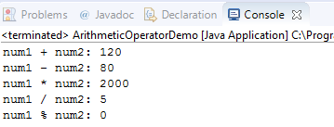
public class ArithmeticOperatorDemo {
public static void main(String args[]) {
int num1 = 100;
int num2 = 20;
System.out.println("num1 + num2: " + (num1 + num2) );
System.out.println("num1 - num2: " + (num1 - num2) );
System.out.println("num1 * num2: " + (num1 * num2) );
System.out.println("num1 / num2: " + (num1 / num2) );
System.out.println("num1 % num2: " + (num1 % num2) );
}
}

Slide 13
Assignment Operators
Operators | Example | Description
= | count=1 | Assign value 1 to count variable
+= | count+=1 | count = count+1
-= | count-=1 | count = count-1
*= | count*=2 | count = count*2
/= | count/=4 | count = count/4
%= | count%=2 | count = count%2

Slide 14
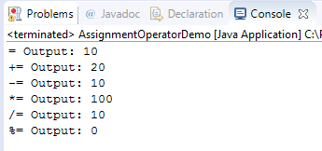
public class AssignmentOperatorDemo {
public static void main(String args[]) {
int num1 = 10;
int num2 = 20;
num2 = num1;
System.out.println("= Output: "+num2);
num2 += num1;
System.out.println("+= Output: "+num2);
num2 -= num1;
System.out.println("-= Output: "+num2);
num2 *= num1;
System.out.println("*= Output: "+num2);
num2 /= num1;
System.out.println("/= Output: "+num2);
num2 %= num1;
System.out.println("%= Output: "+num2);
}
}

Slide 15
Unary Operators
Operators | Description
++ | Increment
-- | Decrement

Slide 16
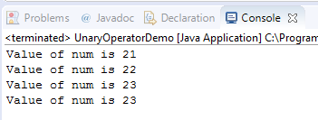
public class UnaryOperatorDemo {
public static void main(String[] args) {
int num=20;
num++;
System.out.println("Value of num is "+num++);
System.out.println("Value of num is "+num);
System.out.println("Value of num is "+(++num));
System.out.println("Value of num is "+num);
}
}

Slide 17
Comparison Operators
Operators | Description
== | returns true if both the left side and right side are equal
!= | returns true if left side is not equal to the right side
> | returns true if left side is greater than right
< | returns true if left side is less than right side
>= | returns true if left side is greater than or equal to right side
<= | returns true if left side is less than or equal to right side

Slide 18
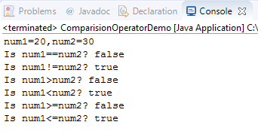
public class ComparisionOperatorDemo {
public static void main(String[] args) {
int num1 = 20;
int num2 = 30;
System.out.println("num1="+num1+",num2="+num2);
System.out.println("Is num1==num2? "+(num1==num2));
System.out.println("Is num1!=num2? "+(num1!=num2));
System.out.println("Is num1>num2? "+(num1>num2));
System.out.println("Is num1<num2? "+(num1<num2));
System.out.println("Is num1>=num2? "+(num1>=num2));
System.out.println("Is num1<=num2? "+(num1<=num2));
}
}

Slide 19
Logical Operators
Operators | Description
&& | AND operator
|| | OR operator
! | NOT operator

Slide 20
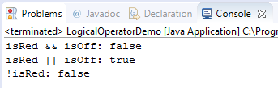
public class LogicalOperatorDemo {
public static void main(String[] args) {
boolean isRed = true;
boolean isOff = false;
System.out.println("isRed && isOff: "+(isRed && isOff));
System.out.println("isRed || isOff: "+(isRed || isOff));
System.out.println("!isRed: "+(!isRed));
}
}

Slide 21
Activity#2
Answer the following
if x = 50 and y = 100 then what is y after y += x; ?
if x = 50 and y = 100 then what is y after y - = x; ?
if x = 50 and y = 100 then what is y after y *= x;?
if x = 50 and y = 100 then what is y after y /= x;?
if a = 2, b = 3, and c = 4 then what is c after c *= a + b; ?
Then write Java code to verify your answer
10mn

Slide 22
Activity#3
What is the output?
double x;
int y;
x = 4.36;
y = (int)(100*x);
System.out.println ("x = " + x + " and 100 times x = " + y);
Then write Java code to verify your answer.
10mn

Slide 23
Control Statement

Slide 24
if statement
Syntax
If the is True, Statement(s) in side if block is/are executed
If the is False, Statement(s) in side if block isn’t/aren’t executed
if(condition){
Statement(s);
}
condition
condition

Slide 25

Example: check if a given number is lesser than 100
public class IfStatementExample {
public static void main(String[] args) {
int num=70;
if( num < 100 ){
//This println statement will only execute, if the above condition is true
System.out.println("number is less than 100");
}
}
}

Slide 26

Activity#4
Write Java to check if a given number is positive.
If the number is 9
If the number is -9
10mn

Slide 27
if else
Syntax
if(condition){
Statement(s); //This statement(s) will only execute, if the above condition is true
}else{
Statement(s);
//This statement(s) will only execute, if the above condition is false
}

Slide 28

Example: check if a given number is lesser or greater than 100
int num=70;
if( num < 100 ){
//This println statement will only execute,if the above condition is true
System.out.println("number is less than 100");
}else {
//Execute if the condition is false
System.out.println("number is greater than 100");
}

Slide 29
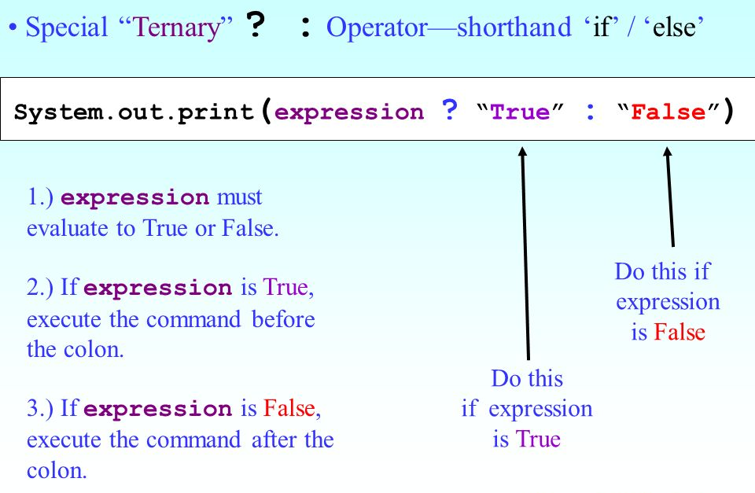
int num=70;
System.out.println(num<100?"number is less than 100":"number is greater than 100");

Slide 30


Activity#5
Write Java to check if a given number is positive or negative
If number is 10
If number is -1
10mn

Slide 31
If else if
Syntax
if(condition1){
Statement(s); //This statement(s) will only execute, if the above condition is true
}else if(condition2){
Statement(s);
//This statement(s) will only execute,
if condition1 is false and condition2 is true
}else if(condition3){
Statement(s);
//This statement(s) will only execute,
if condition2 is false and condition3 is true
}else{
Statement(s);
//This statement(s) will only execute,
if all the above conditions are false
}

Slide 32

Example: check is a given number is 0 or positive or negative
int number = 0;
if(number==0) {
System.out.println(number+" is Zero");
}else if(number>0){
System.out.println(number+" is Positive");
}else {
System.out.println(number+" is Negative");
}

Slide 33
Activity#6
Write Java to check your score
If score less than 50 output “You Fail” to console
If score between 50 and 90 output “You Pass” to console
If score is greater than 90 output “Congratulation!!” to console
15mn

Slide 34
Switch
Syntax
switch (expression) {
case value1:
// statement(s)
break;
case value2:
// statement(s)
break;
.
.
.
case valueN:
// statement(s)
break;
default:
// statement(s)
}

Slide 35

Ex: output the size description bases on char
char size='S';
String sizeDescription;
switch (size) {
case 'S':
sizeDescription="Small";
break;
case 'M':
sizeDescription="Medium";
break;
case 'L':
sizeDescription="Large";
break;
default:
sizeDescription="Not in the stock";
break;
}
System.out.println(size+" is "+sizeDescription);

Slide 36

Activity#7
Add price to previous example
S: price is 5$
M: price is 5.5$
L: price is 6$
15mn

Slide 37
Loop

Slide 38
for()
while()
do{}while()

Slide 39
for()
Syntax
for(initialization; condition ; increment/decrement)
{
statement(s);
}

Slide 40

Example: output to console number 1 to 10
for(int i=1;i<=10;i++) {
System.out.print(i+" ");
}

Slide 41

Activity#8
Write Java program to output number from 10 to 1 to console using for loop
10mn

Slide 42
while()
Syntax
condition is evaluated first and
if it returns true then the statements inside while loop execute.
When condition returns false, the control comes out of loop and jumps to the next statement after while loop.
while (condition) {
//statement(s)
}

Slide 43

Ex: output number from 0 to 10 to console
int i=0;
while(i<=10) {
System.out.print(i+" ");
i++;
}

Slide 44

Activity#9
Write Java program to output number from 10 to 0 to console using for while
10mn

Slide 45
do{}while()
Syntax
Statement(s) is/are executed first then check the condition. If the condition is true repeating execution.
Loop is executed at least once
do {
//statement(s)
} while (condition);

Slide 46
Ex: output number from 0 to 10 to console
int i=0;
do {
System.out.print(i+" ");
i++;
} while (i<=10);

Slide 47
Activity#10
Write Java program to output number from 10 to 0 to console using for do while
10mn

Slide 48
Q&A

